Slide 1

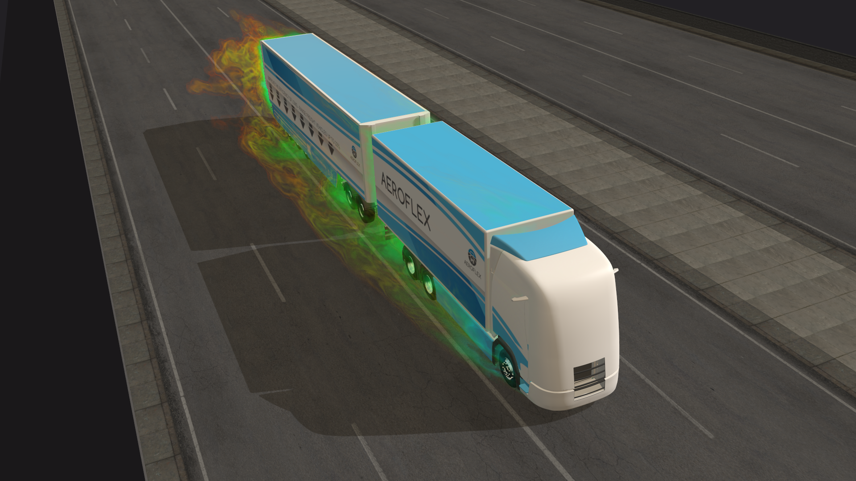
AEROFLEX HIGH-CAPACITY ROAD TRANSPORT
FOCUSSING INNOVATION ON
SMARTER MOBILITY SOLUTIONS FOR SMARTER POLICIES
Invitation to join the final event of the project
28 September 2021
After 46 month of hard work,
we are proud to demonstrate and present the innovations developed within AEROFLEX and show the pathway to improve long-haul road freight transport efficiency up to 33%

